Slide 1
Blended learning AAU Business School
Inspiration catalogue

Slide 2
Agenda
Purpose of the inspiration catalogue
Data & inspiration
Overall learning outcomes
Student feedback
Faculty feedback
International & National experiences
Five significant elements of learning
Inspiration from our colleagues
Moving forward

Slide 3
Purpose of the inspiration catalogue
Use our learning and experiences from two semesters regarding online/campus & synchronous/asynchronous teaching to further discuss what we mean when we say we apply PBL in our learning spaces.
Develop an approach to blended learning that make sense – to us and our students.
Strengthen our conditions for balancing teaching & research in sustainable ways.
Support a learning community at AAUBS where we support each other in developing innovative, individual and unique ways of teaching.

Slide 4
Primary data & inspiration
Surveys from our own full time students Spring and Fall semester 2020.
Focus group interview with our own full time students Winter 2020.
Focus group interview with our local digital support task force.
Our own faculty survey Winter 2020
Student society’s two surveys – qualitative and quantitative Summer and Fall 2020.
AAU survey at Faculty level Summer 2020.
Recurrent theme on monthly HSB meeting from March 2020 – now.
”Students experience of online teaching at the 1st Semester” (EVA survey, Winter 2020)
”Experiences with digitalising adult and continuing education” (EVA survey , 2019)
”Time to study – good examples on continuing education with study intensity” (Danish Ministry of Education and Research survey, Winter 2020)
”Competences for a digital worklife” (Survey, Danish Industry, 2020)
Bates, T. A. W. (2019). Teaching in a Digital Age.
Multiple shorter articles that summarize experiences from other Business Schools.

Slide 5
Overall learning outcomes
Blended learning spaces offer sustainable ways to support PBL anchored learning.
Learning revolves around creating strong relations with students.
We need to strengthen the structures around our PBL anchored blended learning spaces if we want to realize our ambitions.

Slide 6
Student society surveys & focus group interview
Overall findings:
This is not a question about digitalisation as much as it is a question about what PBL is for us – indepent of mode of delivery.
Taking an education and learning is dependent on ensuring our well-being.
When everything is online, our studies become secondary to us and we start identifying elsewhere.
PBL is for us synonumous with dialogue, questions, interactions and not monologue.
We learn when fellow students ask questions, we engage in learning groups, reflect on material presented, get feedback and are in dialogue with the faculty.
A more coherent structure between modules and on moodle would minimize frustration and complexity.
Are our faculty thriving…?
Is the quality lower…?
Invite us into the conversations, we have much at heart here ☺
(Student Society – 8 focus group interviews with 35 students, Student Society questionnaire 760 students (26,4% social sciences’ students) & 1 focus group interview with 4 of our own full time students)

Slide 7
Student survey Spring 2020 Executive summary version
The response rate on the questionnaires has been between 34% and 52%
Between 64% and 81% expressed they were satisfied or very satisfied with the digital delivery of teaching and supervision.
The evaluation is overarching positive with comments varies from digitalisation being better than the regular lectures and supervision to arguing it is not working at all.
Positive aspects | Challenges to be discussed
Flexibility increases. Convenience - Easier to focus and take the lectures and knowledge in at their own pace. Customized learning style - Pause or/and revisit when needed. Boozt exam preparation - Support preparation for exams. | Tech. Support!!! - Sound and video has to work. Prioritise - The use of different platforms makes it confusing for students. Less is more - Too playful use of many different or new media makes it to hard for the students to participate and keep up. Dialogues matter - Difficult to have two-way communication and interaction during lectures.

Slide 8
Student survey Fall 2020 Executive summary version
All comments are to be read as: ”When it could not be different, then…”
In average more than 50% of our full time students expressed they were satisfied or very satisfied with the digital delivery of teaching and supervision.
Asynchronous videos presenting the fundamentals or recorded synchronous lecturers enhance our learning.
Their preferences have changed from speak over PP to more interactive ways of teaching online.
Live streaming – when it worked technically was valued highly – gave a sense of almost being there.
Many express they have not missed any lecturers as they could participate online.
Positive aspects | Challenges to be discussed
Convenience, focus, flexibility, customize. Chat function – between faculty & students and amongst students. A focused, structured and interactive online module enhances learning. Relations amongst students in break out rooms, learning groups with clear expectations supported learning and well-being. When a personal teaching style and effort to use the digital resources as surplus learning are applied, vibrant learning occurs. | Technical challenges is a huge frustration. Motivation, concentration can be challenged. Many express they prefer a blended learning approach. Miss being at campus – a central aspect of studying at a university. Lecturers express the quality of the learning is decreasing.

Slide 9
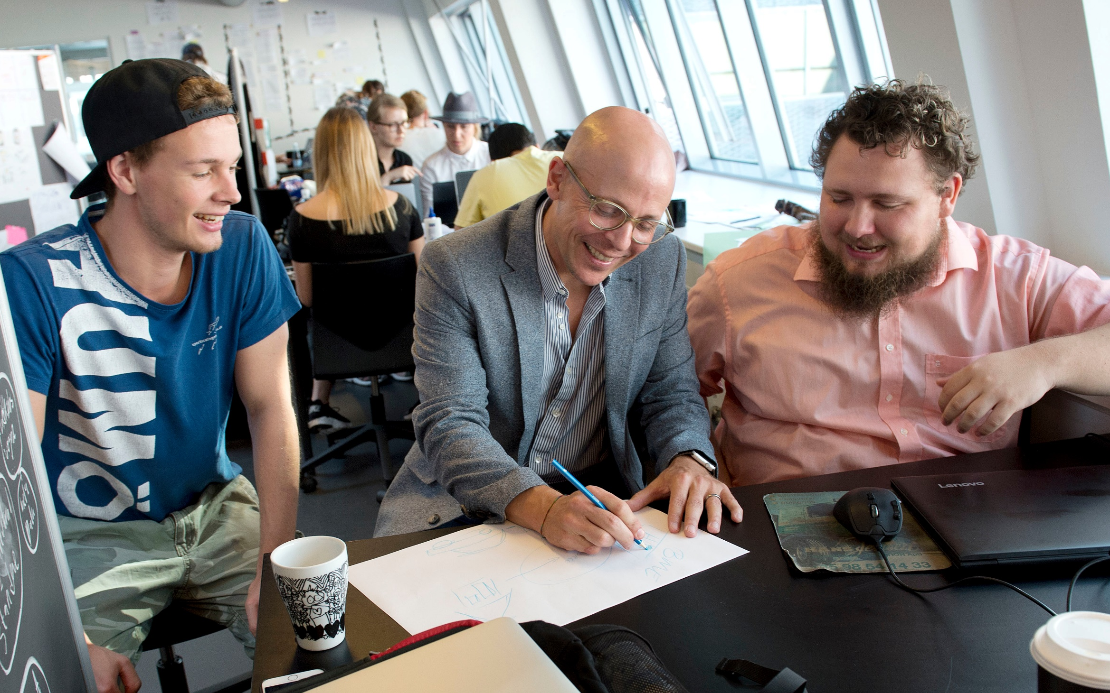
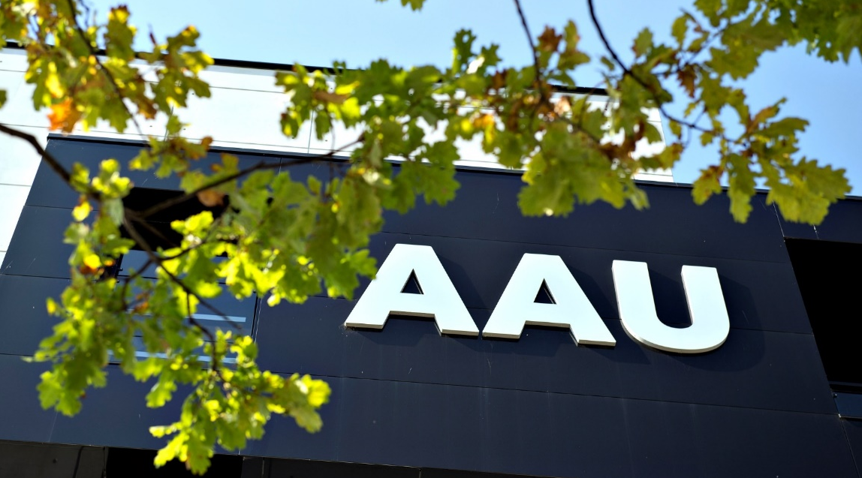
Faculty feedback I
This is not a question about digitalisation as much as it is a question about what PBL is for us – indepent of mode of delivery.
Find OUR mix and way to move forward.
Online offers flexibility, accesibility and saves times - for everyone.
Asynchronous teaching can enhance learning – as students can access learning material when and how they prefer – individually and in groups.
Lots of pockets of good practice - experiments with different settings, platforms and tools shapes competencies in teaching.
Ability to become more efficient and structured in our teaching – more time for research.
Greater attendance to online classes than on campus.
The more shy students are more comfortable with the chat.
Peer review/feedback, flipped classroom, videos, quizzes, sharing of material etc. function very good online.
Let us focus on the content and let others deal with the upload etc.

Slide 10
Faculty feedback II
We are still learning. Ressources, experience and time is needed if we are to become reflective practitioners in online teaching.
Online teaching makes communicating and relating with students more formal and distanced.
Great tool for supervision – but be careful of your time and accessibility.
Difficult to create vibrant and engaging interactions with students.
Black screens and no feedback affect the motivation and well-being.
Asynchronous material is good for delivering information.
Critical thinking and quality in group work comes from being together.
Possibility for the module team to cooperate and rethink the module content and structure.
Online can be a part and also a significant part of PBL, but not on its own.
Our own faculty survey, Focus group interview with our local digital support task force, AAU survey at Faculty level & recurrent dialogues on monthly HSB meeting)

Slide 11
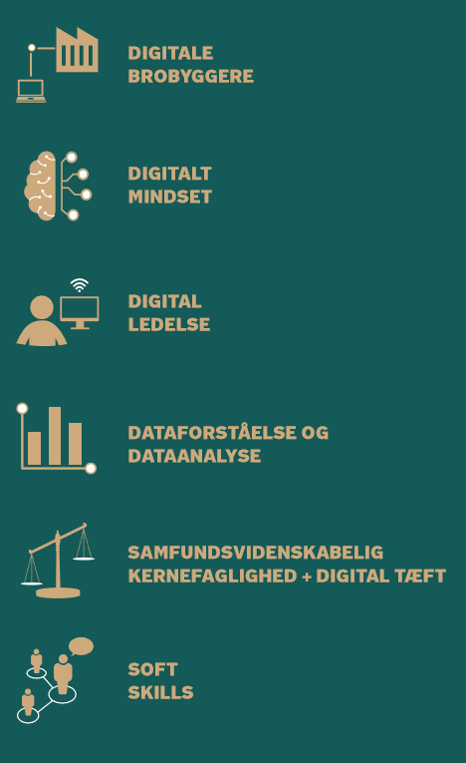
International & National experiences I
Study intensity is the outcome of:
A clear expectations from faculty to students.
Strong social relations between students, fellow students and faculty.
Clearly articulated commitments between faculty and students regarding ensuring a shared responsibility for learning.
55% of 1st year University students miss the social relations with fellow students.
44% of 1st year University students miss being at campus.
Future employers expect that Social Science students are able to function as digital integrators and develop a digital mindset & digital competences during their education.
(Eva, 2020, 2020, DI, 2020, DMER, 2019)

Slide 12
International & National experiences II
5 ways to support better digital learning amongst students
Be clear about online qualifications among students &
Give a thorough introduction to the virtual learning space
Support relation building amongst students
Create strong relations between students and faculty
Provide academic support to students &
Use tools that activate learning
Support the development of technical and didactical competencies amongst faculty.
(Reworked from Eva, 2020)

Slide 13
Five significant elements of learning
Preparation
Lecture
Q&A
Learning groups
Facilitated learning

Slide 14
Preparation
Reading, seeing, hearing, writing notes is one aspect of PBL.
Aqcuiring knowledge is an integrated aspect of our learning objectives on all modules.
Studying, reading and being able to engage qualified in dialogues require preparation.
Provide academic support to students.
A way to make commitments between students and faculty clear.
Reflection occur as arguments are put together in relation to various academic sources.
Can be individually or in learning groups.
Preparation can be in the form of literature, surveys, asynchronous digital material.

Slide 15
Lecture
Listening, seeing, writing notes and having your meaning structures challenged is one aspect of PBL.
A possibility for faculty to disseminate research based knowledge and illustrate the craft of being a reflective practitioner.
A safe arena for inviting students into pausing their instanous sensemaking and understanding and open up for different perspectives.
Present, unfold, analyse and unite complex theoretical and practical questions.
Motivating and meaningful to many researchers.
Provide academic support to students.
A way to make commitments between students and faculty clear.
Can be realised asynchronous/synchronous & digitally/on campus.

Slide 16
Q&A
Reflecting, verbalising one’s understanding, being asked to relate to specific issues is one aspect of PBL.
We remember 70% of what we say.
Students express that a central part of their learning occurs when they hear fellow students raise questions.
Q&A revolves around dialogue.
Support relation building amongst students.
A way to create strong relations between faculty & students.
Provide academic support to students.
A tool that active students and support their learning.
Can be individually or in learning groups.
Can be realised digitally or on campus, individually or in learning groups, questions can be formulated synchronous or asynchronous and verbally or written (chat).

Slide 17
Learning groups
Reflexive dialogues where meaning structures are challenged and new understanding emerge is one aspect of PBL.
Complex real-time problems are solved with minds who do not think alike.
Focus on the social and academic aspect of students’ well-being.
A tool that active students and support their learning.
A way to make commitments between students and faculty clear.
Clear expectations from faculty to students that wil qualify what occur in lectures, facilitated learning, Q&A sessions and preparation. Hence, indirectly support faculty’s well-being.
Learning groups can meet online, on campus, at home or...

Slide 18
Facilitated learning
"I hear and I forget.
I see and I remember.
I do and I understand.“ (Confucious)
Supporting critical thinking, learning through apprenticeship and doing is one aspect of PBL.
Skills and competences are expressed in all our modules are best acquired through doing (safe environments).
Provide academic support to students.
Learning dialogues that support relations amongst faculty and students.
A way to make commitments between students and faculty clear.
An arena for creating vibrant and engaging interactions with students.
Realization of how learning is a shared responsibility.
Facilitated learning can be realised online or on campus and in learning groups or at the whole cohort.

Slide 19
Inspiration from our colleagues
m

Slide 20
Inspiration from our colleagues
m

Slide 21
Inspiration from our colleagues
m

Slide 22
Inspiration from our colleagues
m

Slide 23
Inspiration from our colleagues
m

Slide 24
Moving forward regarding the overall learning outcomes
Blended learning spaces offer sustainable ways to support PBL anchored learning.
Learning revolves around creating strong relations with students.
We need to strengthen the structures around our PBL anchored blended learning spaces if we want to realize our ambitions.

Slide 25
Moving forward
Interplay between each activity on every module.
Blended learning spaces offer sustainable ways to support PBL anchored learning.
Different modes of delivery and platforms are suitable for different kinds of learning. There is a diiference between learning the fundamentals of a theory and developing critical thinking.
Furthermore, we are motivated by different learning styles, so ask yourself:
When using online platfomrs, what are the online qualifications amongst the students and how can I best introduce them to the virtual learning spaces?
Where and how can I create clear expectations and strong relations with my students?
What tools can I use to activate the students’ learning?
How can I support relation building amongst the students?
Where and how can I provide academic support to students?
Answering these questions, keep the different possibilities open:
Synchronous | Asynchronous
Online | Campus
Individually | Learning groups

Slide 26
Moving forward
Interplay between each activity on every module.
Learning revolves around creating strong relations with students.
Rely on our shared expectations to students articulated in ”Learning agreement online and on campus”
An Advisory Board with students from each cohort, the HSB and me will meet 2 times per semester to discuss the well-being of students on the cohort and how we best can ensure that.
Student tutors will be hired for each cohort to support realising social interactions online and on campus.
Regarding the central aspects of learning; preparation, lecture, Q&A, learning groups and facilitated learning in your modules:
Align you expectations to what is possible in the chosen mode of delivery and platform.
Express clearly your expectations to the students –what do you expect from the students? When and how.
Articulate clearly commitments between you and the students regarding ensuring a shared responsibility for learning. Who is responsible for what, how and when?
Involve the team around the module.
Be true yet resilient to your preferred teaching style.

Slide 27
Moving forward
Interplay between each activity on every module.
We need to strengthen the structures around our PBL anchored blended learning spaces if we want to realize our ambitions.
4 AAUBS online courses (technical & didactical) organised by CDUL this Spring.
New studios for recording online material synchronous and asynchronous for both faculty & students.
Inspiration catalogue to help you on the way – talk with each other and me.
We will hire teaching assistants to help you get your online materials uploaded.
We still have our local digitalt team you can book for support.
Organize your teaching in ways where your investments in e.g. asynchronous lecturers, learning group assignments, faclitated learning processes will release time to research in the long run.

Slide 28
Learning at AAUBS
We are ambitious on your behalf.
We expect the same of you.

Slide 29
Questions & comments Mette Vinther Larsen: mvl@business.aau.dk

