Slide 1
Development of Value creation in Dialogue with Partners IFD-SSH Call october 2020
Mads Bennedsen (AAU Innovation)

Slide 2
Call Objective - Its about partnerships & Societal Challenges
The objective with this call is to invest in research-based projects within social sciences and humanities, involving partnerships from public and private institutions (universities, municipalities, schools, hospitals, companies, NGO´s, consultancy, unions, etc.) that contribute to solutions to major societal challenges globally and in Denmark.

Slide 3
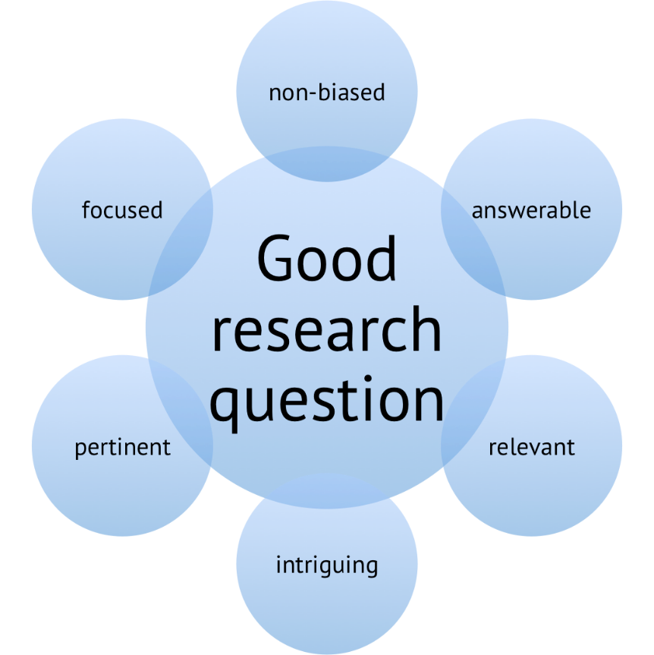
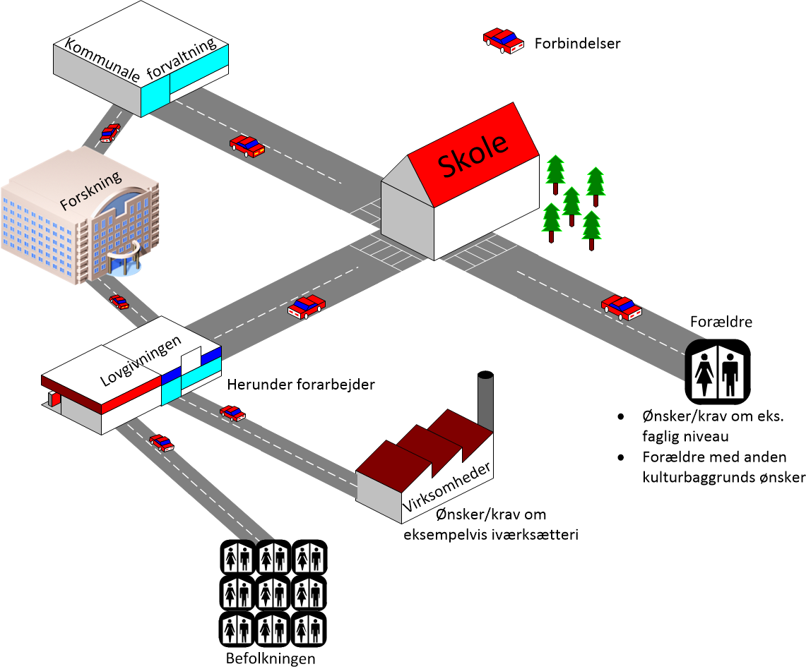
Value Creation in research focused projects

Slide 4
Value creation in research-focused projects
The model works, because there is alignment between the value perception of the funding provider and the researcher!
(Basic) Research and scientific excellence is the goal, societal change comes second.
Value for a academic researcher is scientific merits and publications.
Scientific career
More Funding

Slide 5
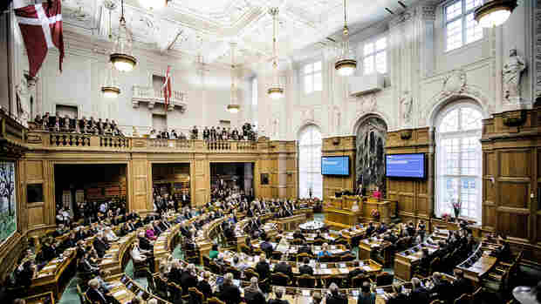
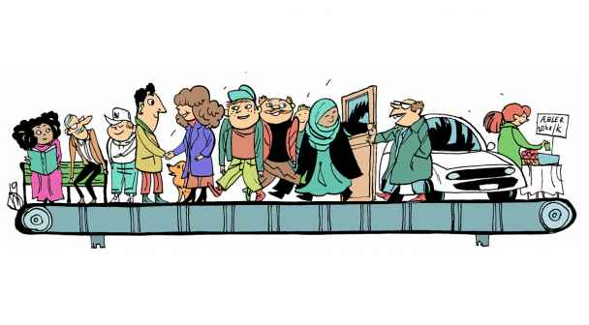
Value Creation in collaborative EU/IFD projects
Problem owner
Parlament
Co-investment
Problem solver
Societal Challenge
Society
Consortium
Konsortium

Slide 6
IFD has a mindset of a Capital Fund!
IFD co-invest tax money in the project consortium for solving societal challenges.
Project owner and/or project solver has to co-invest with significant amount also.
Projects are selected on basis of ”Return of Investment”, in terms of job creation in Denmark, tax payment, cost reductions for public stakeholders, ………
Because of the public money, they want to protect themselves against shitstorms:
Solid project execution has to be demonstrated
Solid post-project implementation plan and clear ownership of solution
Impact has to be specific & measureable
Solution should be scaleable….
If IFD is a Capital Fund, then you are in Dragons Den. In order to win, you have to be as pursuasive as an
”Used Car Dealer”!

Slide 7
IFD Evaluation Criteria (i):
Quality of research and innovation:
IFD is looking for cutting-edge ideas with a high level of research and innovation that offer solutions to relevant and specific needs. The research and innovation excellence is assessed in terms of originality, state-of-the-art and combination of new methods.
Furthermore, we focus on the partner composition and inclusion of relevant competencies and qualifications that together contribute to the idea, solution and value creation of the project, including potential involvement of relevant international partners.

Slide 8
IFD Evaluation Criteria (ii):
Value creation during and after the project period:
Value creation is understood in broad terms, among others, as targeted innovation activities that solve major societal challenges. Examples are:
Reduced costs for the society,
reduced environmental –or resource footprints,
Improved quality of life, optimised processes,
Increased revenue from domestic sales or exports, etc.
It is important that the application makes probable an estimated and expected value creation of the project in terms of quantitative and/or qualitative measures, based on expected launch or implementation into the society, even if this happens after the investment period.

Slide 9
IFD Evaluation Criteria (iii):
Efficiency of project execution:
The application has to have an operational project plan where the project is organised in work packages. We need to understand how the project will come to life, and which steps it will follow.
A good project has a team composition that matches the project´s objectives. IFD considers diversity in the projects team as a resource; greater diversity helps bringing the performance on measures such as innovation, collaboration and critical thinking to a higher level. Ideally, the main beneficiaries of the project are part of the team.

Slide 10
IFD Evaluation Criteria (iv):
Implementation of results:
A good application describes how the project results are implemented into society, even if this is after the investment period. We want to know who will use, invest in, or own/manage the project outcome once the investment from IFD has ended.
Goals have to be SMART & Scaleable => 10-100 X Return of Investment
It is important to note that IFD does not invest in pure research or data gathering projects with no specification of a concrete implementation plan.

Slide 11
How to create Value in projects:
Important questions:
What is the problem or the ”Unmet Need”?
Who owns the problem
How can the problem be solved and by whom
Who are the competitors?
What is the cost of the competing solution?
What is the ideal consortium for solving the problem
How do we ensure succesful implmentation
What is the Value / Impact of the solution?
You are in competition with
Other solutions to the same problem
Other projects solving other problems
The winner is highest impacct!
Scaleable project win!

Slide 12
Value from excellence:
The succesful application demonstrate excellence in:
science
consortia-building
project execution
Including ability to re-orient
Post project implementation
Getting value out of the invention
Society

Slide 13
Building the consortium:
Identify the ”Dream Team”
The best scientists in the field
The ”problem owners”
Implementation agent / ”Problem Solver
IT company
Consultant
Problems are defined & potential solutions difined in collaboration!
Remember, nobody participate in the project unless it has strategic importance for them & create value
Speed of trust => succesful collaborations

Slide 14
Create a virtual company
LISES approach
27% chance of success
73% chance of success
Share people & facilites in order to become a virtual company
Place project scientists with the collaborators!
Ensure information flow & build trust (Knowledge mobilization ”LISES”)
Enlarge the role of partners

Slide 15
Co-Financing:
It is expected, that the value creation for the indidual partner & the consortiumis reflected in the amount of cofinancing from the partners!
IFD demands cofinancing from ALL partners (In Kind or cash)
In Kind can be the value of manpower, access to test platforms, commercial data etc.
The ”rule of thump is: 50% of the budget should be with the partners.

Slide 16
Project Funding, Grand Solutions
Partner is interested to spend up to 2 mio dkk
Company
IFD
AAU
Equipment & materials
500.000 kr
Total Support
5.000.000
Researcher salary
6 months
500.000
Postdoc 2 year
2.400.000
Support company
2.100.000
Postdoc 2 year
1.800.000
Other employees working on project 6 months
600.000
Support AAU
2.900.000
Other expenses
1.000.000
Total expenses 3.500.000
Cofinancing need:
1.400.000
Actual cost: 500.000 + 1.200.000
De minimis support 1.500.000 / non-de minimis 600.000
Total expenses 3.500.000
Cofinancing need:
350.000

Slide 17
”The good proposal”
You need to have a good idea!!!
Have the right team
The proposal should address the call topic
Good ideas can always be presented short and precise
A well written proposal
Describe why the project is important and justify the methodology
Excite the evaluator within the first 5-15 minutes of reading
Expect the evaluator to be a good generalist
Make clear what is innovative and beyond state-of-the art
Good illustrations that can be understood within 5-15 seconds
Describe project risks and present a mitigation plan
Follow the Guide for Proposers (the evaluation criterias usually do so)
Describe how the team can perform the tasks and are complementary
The project coordinator should have clear competences
Describe dissemination and IPR so it catches the reader and appears to be exciting
Describe the IMPACT: “Will this project ever make any difference?”

Slide 18
Evaluation criteria from IFD:
2.3.3 Effektivitet i projektudførelse, vurderes med hensyn til:
a) Projektets arbejdsplan, herunder arbejdspakker og disses indbyrdes afhængighed, milepæle, kritiske stier og delleverancer
b) Projektets ledelse, beslutningsprocesser, organisering, styring samt projektteamets sammensætning
c) Projektets risici og håndtering af disse ifb med projektets afvikling
d) Håndtering af eventuelle etiske eller regulatoriske aspekter
2.3.4. Implementering af resultater, vurderes med hensyn til:
a) Aftagere til projektets resultater og overdragelsen heraf
b) Implementering af projektets resultater også efter afslutningen af projektet og håndtering af eventuelle økonomiske eller samfundsmæssige barrierer herfor
c) Supplerende finansiering (gearing) ud over projektets eget budget

Slide 19
Evaluation criteria from IFD:
2.3.1 Excellence – Kvalitet af forskning og innovation, vurderes med hensyn til:
a) Projektets mål
b) Behov og udfordringer som projektet adresserer
c) State-of-the-art (SoA) af projektets forskning og innovation
d) Projektets videnskabelige, tekniske og kommercielle konkurrenter
e) Projektets strategiske relevans
f) De anvendte videnskabelige metoder og teknologiske og innovative løsninger
2.3.2 Værdiskabelse, vurderes med hensyn til:
a) Om den anvendte viden og udviklede teknologi og innovation fører til vækst og beskæftigelse i Danmark og/eller bidrager til løsning af konkret(e) samfundsudfordring(er) samt i hvor høj grad værdiskabelsen er kvalificeret eller kvantificeret under og efter projektets levetid.
b) Intellektuelle rettigheder (IPR) i projektet og hvordan disse kan udnyttes i forretningsmæssig sammenhæng

