Slide 1
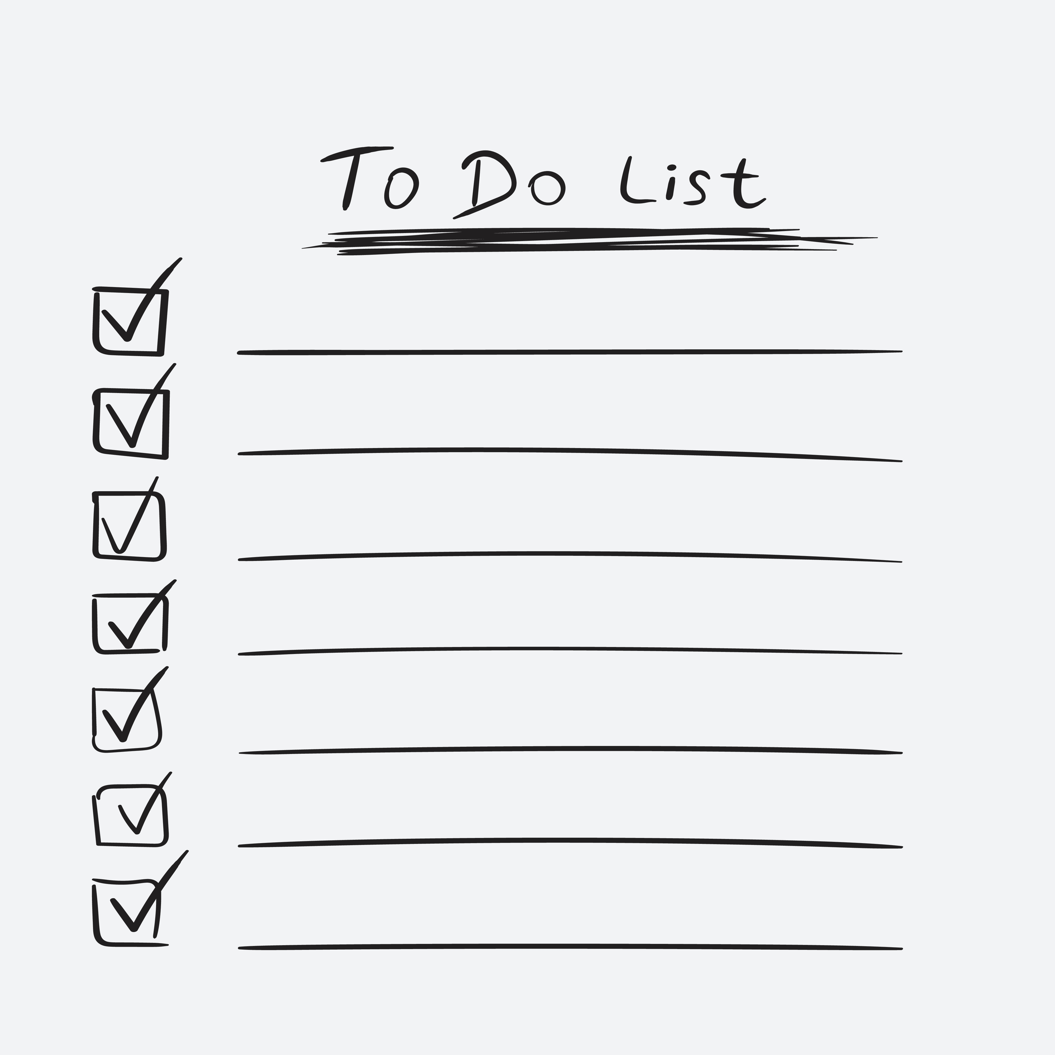

Coronasmitte: Underviseres huskeliste
Risikoen for kontaktsmitte øges, når mange på skift anvender det samme undervisningsrum eller det samme udstyr. Risikoen for dråbesmitte øges, når mange sidder eller står tæt i undervisningssituationer. Det er derfor vigtigt, at du som underviser tilrettelægger din undervisning forsvarligt.
Corona-
precautions
during lectures
FØR UNDERVISNINGEN BEGYNDER
  Mind de studerende om at sætte sig i grupper og holde afstand til andre grupper.
  Mind dem om håndhygiejne, god nyseadfærd og om at undgå fysisk kontakt.
  Udpeg studerende til bordaftørring efter endt undervisning, f.eks. én person pr. række.
  Aftør din mikrofon eller headset inden brug.
UNDERVEJS I UNDERVISNINGEN
  Sørg for god tid til pauser, så sammenstimlen ved indgangen undgås.
  Mind de studerende om fortsat at holde afstand.
  Sørg for selv at holde mindst 2 meters afstand til første række.
VED UNDERVISNINGENS AFSLUTNING
  Mind de udpegede studerende om deres opgave.
  Mind de studerende om at holde afstand, når de forlader lokalet.
  Efterlad tilstrækkelig tid til at andre kan overtage lokalet.
www.aau.dk/coronavirus

Slide 2
Corona infection: Lecturers to-do-list
The risk of contact infection increases when many uses the same classroom or equipment. The risk of droplet infection increases when many people sit or stand closely during a lecture. It is therefore important that you as a lecturer plan your lecture properly.
Corona-
precautions
during lectures
BEFORE THE LECTURE BEGINS
  Remind the students to sit in groups and keep their distance to other groups.
  Remind them of hand hygiene, proper coughing behavior and of avoiding physical contact.
  Point out students for table wiping at the end of the lecture, e.g. one person per row.
  Wipe your microphone or headset before using it.
DURING THE LECTURE
  Make sure there is plenty of time for breaks so that clusters at the entrance is avoided.
  Remind the students to keep their distance at all times.
  Stay at least 2 meters from the front row.
AT THE END OF THE LECTURE
  Remind the appointed students of their task.
  Remind the students to keep their distance when leaving the room.
  Leave sufficient time for others to take over the room.
www.aau.dk/coronavirus

