Slide 1
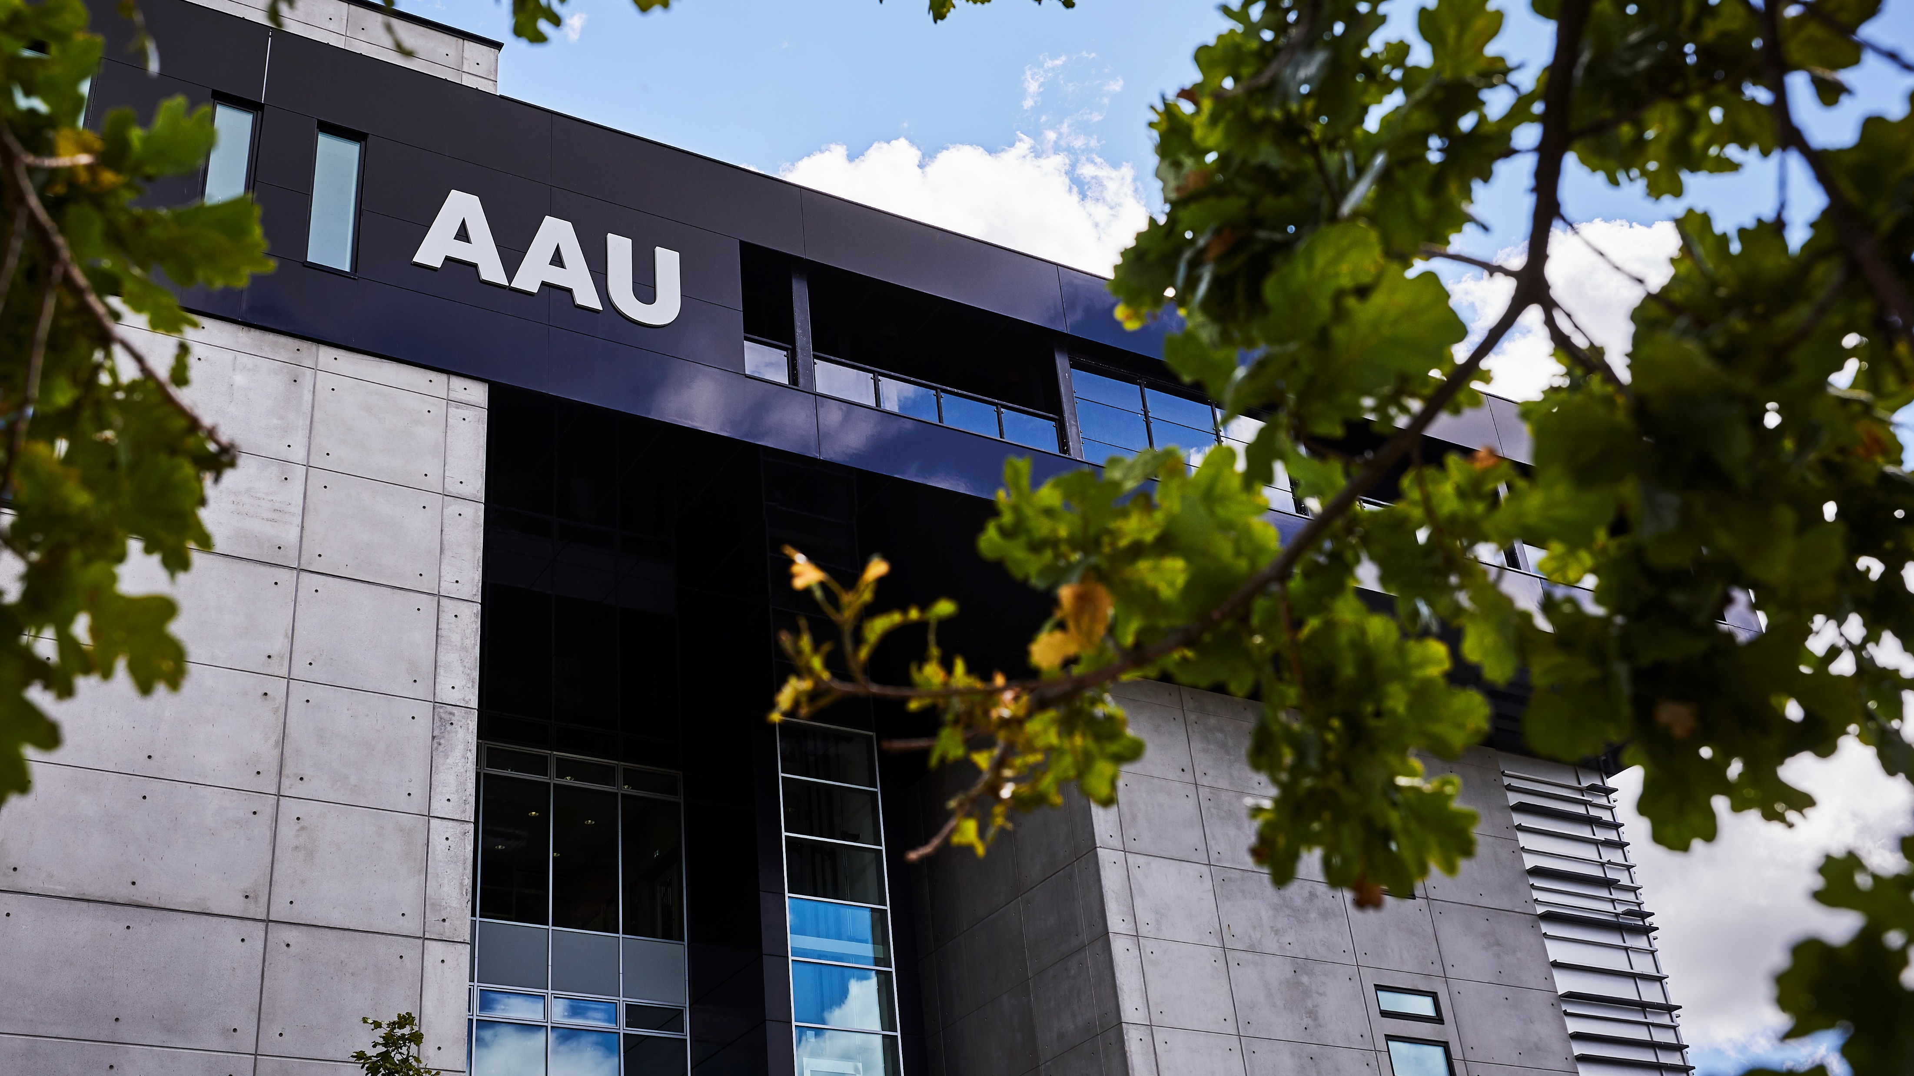
Welcome to Aalborg University Business School
Professor Council meeting 21 August 2020

Slide 2
Agenda
Comments to the agenda
PhD status (orientation)
Short messages:
Meeting schedule
Intranet page for Professor Council
Editors’ Day
Publication and BFI analysis (orientation)
Business Labs and research groups (orientation)
Funding: upcoming calls (orientation)
Faculty level review panel (orientation followed by discussion on implementation)
“Academic Fridays”/Economic Laboratory” (short oral presentation of proposed setup followed by discussion on implementation)
AOB
Next meetings

Slide 3
Short messages: a. Meeting schedule
The two annual meetings will be held Friday in week 9 and Friday in week 34.
Accordingly, the dates for the 2021 and 2022 meetings are
5 March 2021 [Theme: Academic publication]
27 August 2021 [Theme: TBD]
4 March 2022 [Theme: TBD]
26 August 2022 [Theme: TBD]
During the coffee break, please discuss relevant themes for the upcoming meetings: The aim is to have a preliminary plan of themes - and co-organisers - for the next four meetings before closing today’s meeting (item 10).

Slide 4
Short messages: b. Intranet page for Professor Council
https://www.intranet.business.aau.dk/professor-council
Here you can find:
The mandate for the Professor Council
Meeting schedule
Agendas and documents from the meetings
If there is a need for a discussion forum between meetings, we can also make a closed group on Workplace, https://businessaau.workplace.com/

Slide 5
Short messages: c. AAU Business School Editors’ Day
Editors’ Day: a paper development workshop aiming at supporting the process of developing manuscripts for publication in highly ranked international journals. Editors of selected journals will provide feedback on submitted extended abstracts of work in progress, with the aim of supporting the developing the work into papers, that have the potential of being high-quality submissions within the scope of one of the journals represented at the workshop.
Main target group is researchers in the early stage or their career - PhD students, postdocs, assistant professors and associate professors with less than 2 years seniority in the position
Originally scheduled for May 2020 (with editors from Accounting, Auditing and Accountability - Global Strategy Journal -Journal of International Business Studies - Research Policy - Small Business Economics)
A new date will be scheduled as soon as possible (the date will probably be in the early spring of 2021). Editors will most likely join via video.

Slide 6
Publication and BFI analysis
Summary
Overall the number of publications is slightly decreasing. The citation database potential is status quo but the BFI potential is being more and more realised. The share of publications in BFI-level 2 is slightly increasing and receive more impact in terms of citations per publication.
Number of Open Access publications are increasing and the potential is almost realised in 2018 according to the National OA Strategy. OA publications receive more impact in terms of citations.
More than 45% of publications in Scopus are published with international collaboration and get more impact (FWCI). The share of publications in top journals, share of publications in top citation percentiles and Field-Weighted Citation Impact decreases in the period.

Slide 7
Publication and BFI analysis Publication Types

Slide 8
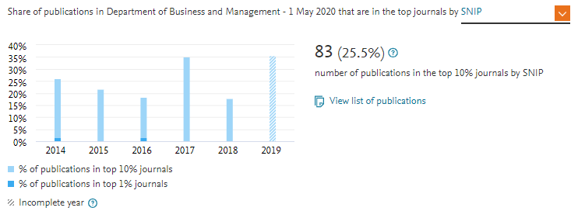
Publication and BFI analysis Publications in Top Journals (SciVal)
Compare with
Top Citations graph (slide 20)

Slide 9
Publication and BFI analysis BFI-levels (share of BFI publications)

Slide 10
Publication and BFI analysis BFI-levels and Impact (entire period)
BFI-level | Share | Publications | Citations | Citations per Publication
1 | 79% | 291 | 171 | 3.4
2 | 21% | 76 | 67 | 9.5

Slide 11
Business Labs and Research Groups

Slide 12
Funding: upcoming calls /1
Innovation Fund Denmark
Industrial PhD, private sector - https://innovationsfonden.dk/en/programmes/industrial-researcher/industrial-phd-all-areas-private-sector, 17 September 2020; and public sector - https://innovationsfonden.dk/en/programmes/industrial-researcher/industrial-phd-all-other-areas-public-sector, 30 September 2020
Industrial Postdoc, private sector - https://innovationsfonden.dk/en/programmes/industrial-researcher/industrial-postdoc-all-areas-private-sector, 17 September 2020; and public sector - https://innovationsfonden.dk/en/programmes/industrial-researcher/industrial-postdoc-all-areas-public-sector, 30 September 2020
Also special calls on Industrial PhDs and Postdocs for public and private firms in Greenland and Faroe Islands, 17 and 30 September 2020
Grand Solutions, Open Call within Social Sciences and Humanities – https://innovationsfonden.dk/en/programmes/grand-solutions/open-call-within-social-sciences-and-humanities, 1 October 2020

Slide 13
Funding: upcoming calls /2
Independent Research Fund Denmark, DFF (https://dff.dk/dff_e2020_f2021_dk.pdf, https://dff.dk/en/application/overview-of-instruments)
DFF-International Postdoc, 6 October 2020 and 26 March 2021
Sapere Aude: DFF-Research Leader, 24 March 2021
DFF Research Project 1 (below 2 mill. DKK) and Research Project 2 (2-4.3 mill. DKK), 2 October 2020
Research stay abroad, 2 October 2020 and 26 March 2021
Scancor
2-year postdoc position (at Scancor, US): Expects call in October or November 2020 with application deadline February 2021 and start September 2021 - https://scancor.org/post-doc/

Slide 14
Funding: upcoming calls /3
Carlsberg Foundation – https://www.carlsbergfondet.dk/en/Applicant/Apply/Call-and-Guidelines, Ordinary Calls, 1 October 2020:
International Fellowships (Two-year postdoctoral fellowships for outstanding PhDs for a research stay at a leading international institution)
Reintegration Fellowships (Two-year postdoctoral fellowships at Danish research institutions after a research stay abroad)
Monograph Fellowships (One-year full-time fellowships for leading, visionary researchers aimed at producing a ground-breaking monograph
Research Infrastructure (Grants for equipment, register data, databases, etc.)
Field Trips / Research Stays at Foreign Institutions (Grants for field trips or research stays at leading international research institutions with a budget exceeding DKK 100,000.)
Also calls for stays at Oxford University or the Danish Academy in Rome (+ for research of relevance for Iceland…)
Continuous Calls, can be applied for throughout the year
Conferences (grants, up to DKK 60,000, for arranging international conferences in Denmark)
Field Trips / Research Stays at Foreign Institutions (Grants for field trips or research stays at leading international research institutions with a budget not exceeding DKK 100,000)

Slide 15
Funding: upcoming calls /4
The Royal Danish Academy of Sciences and Letters
The Lillian and Dan Fink Foundation (supports the dissemination – primarily through funding of publications – of research and development results, aiming at application of the results in business and culture – http://www.royalacademy.dk/da/Legater/Legater/Lillian-og-Dan-Finks-Fond (only available in Danish) yearly, 1 October and 1 April
The Julie von Müllen Foundation (grants to Danish scientists whose research projects depend on them staying at a specific research location, or in case a scientist must travel to a specific place to do fieldwork and collect empirical material or to gain access to certain data bases or archives. Grants are given to PhD students in exceptional cases only) - http://www.royalacademy.dk/en/Legater/Legater/Julie-von-Mullen, 1 October 2020

Slide 16
Faculty level review panel
The Faculty/Deanery is planning a joint faculty level scientific review panel to support applications to selected foundations. The review panel should consist of
Social Sciences researcher with experience from own projects and/or experience as a reviewer with research foundations – as well as SS researcher with other experience in reviewing research applications
Departments/Business School are responsible for
Establishing and maintaining the review panel
Ensuring that reviews are carried out
Departments/Business School decides criteria for which types of applications should be reviewed
For discussion:
How do we implement the review process in a flexible, non-bureaucratic way that can help boost the quality – and thereby success rate - of applications?
Recruiting reviewers?
Criteria for entering the review process (where should it be mandatory, and where only an option)?
Other issues that should be considered?

Slide 17
“Academic Fridays”/Economic Laboratory” (Business School Social)

Slide 18
AOB
Faculty meeting with FSE, Independent Research Fund Denmark on 22 September 2020. Input to the meeting from researchers with experiences from projects with and applications to FSE by 15 September are most welcome
The Deanery will put the following forward
Statistics on success rates?
Would prefer more – and smaller – calls in stead of few with very large budgets
…..

Slide 19
Next meetings
5 March 2021 [Theme: Academic publication. Co-organisers: Svetla, Robin]
27 August 2021 [Theme: … . Co-organisers: …]
4 March 2022 [Theme: … . Co-organisers: …]
26 August 2022 [Theme: … . Co-organisers: …]

